Slide 1
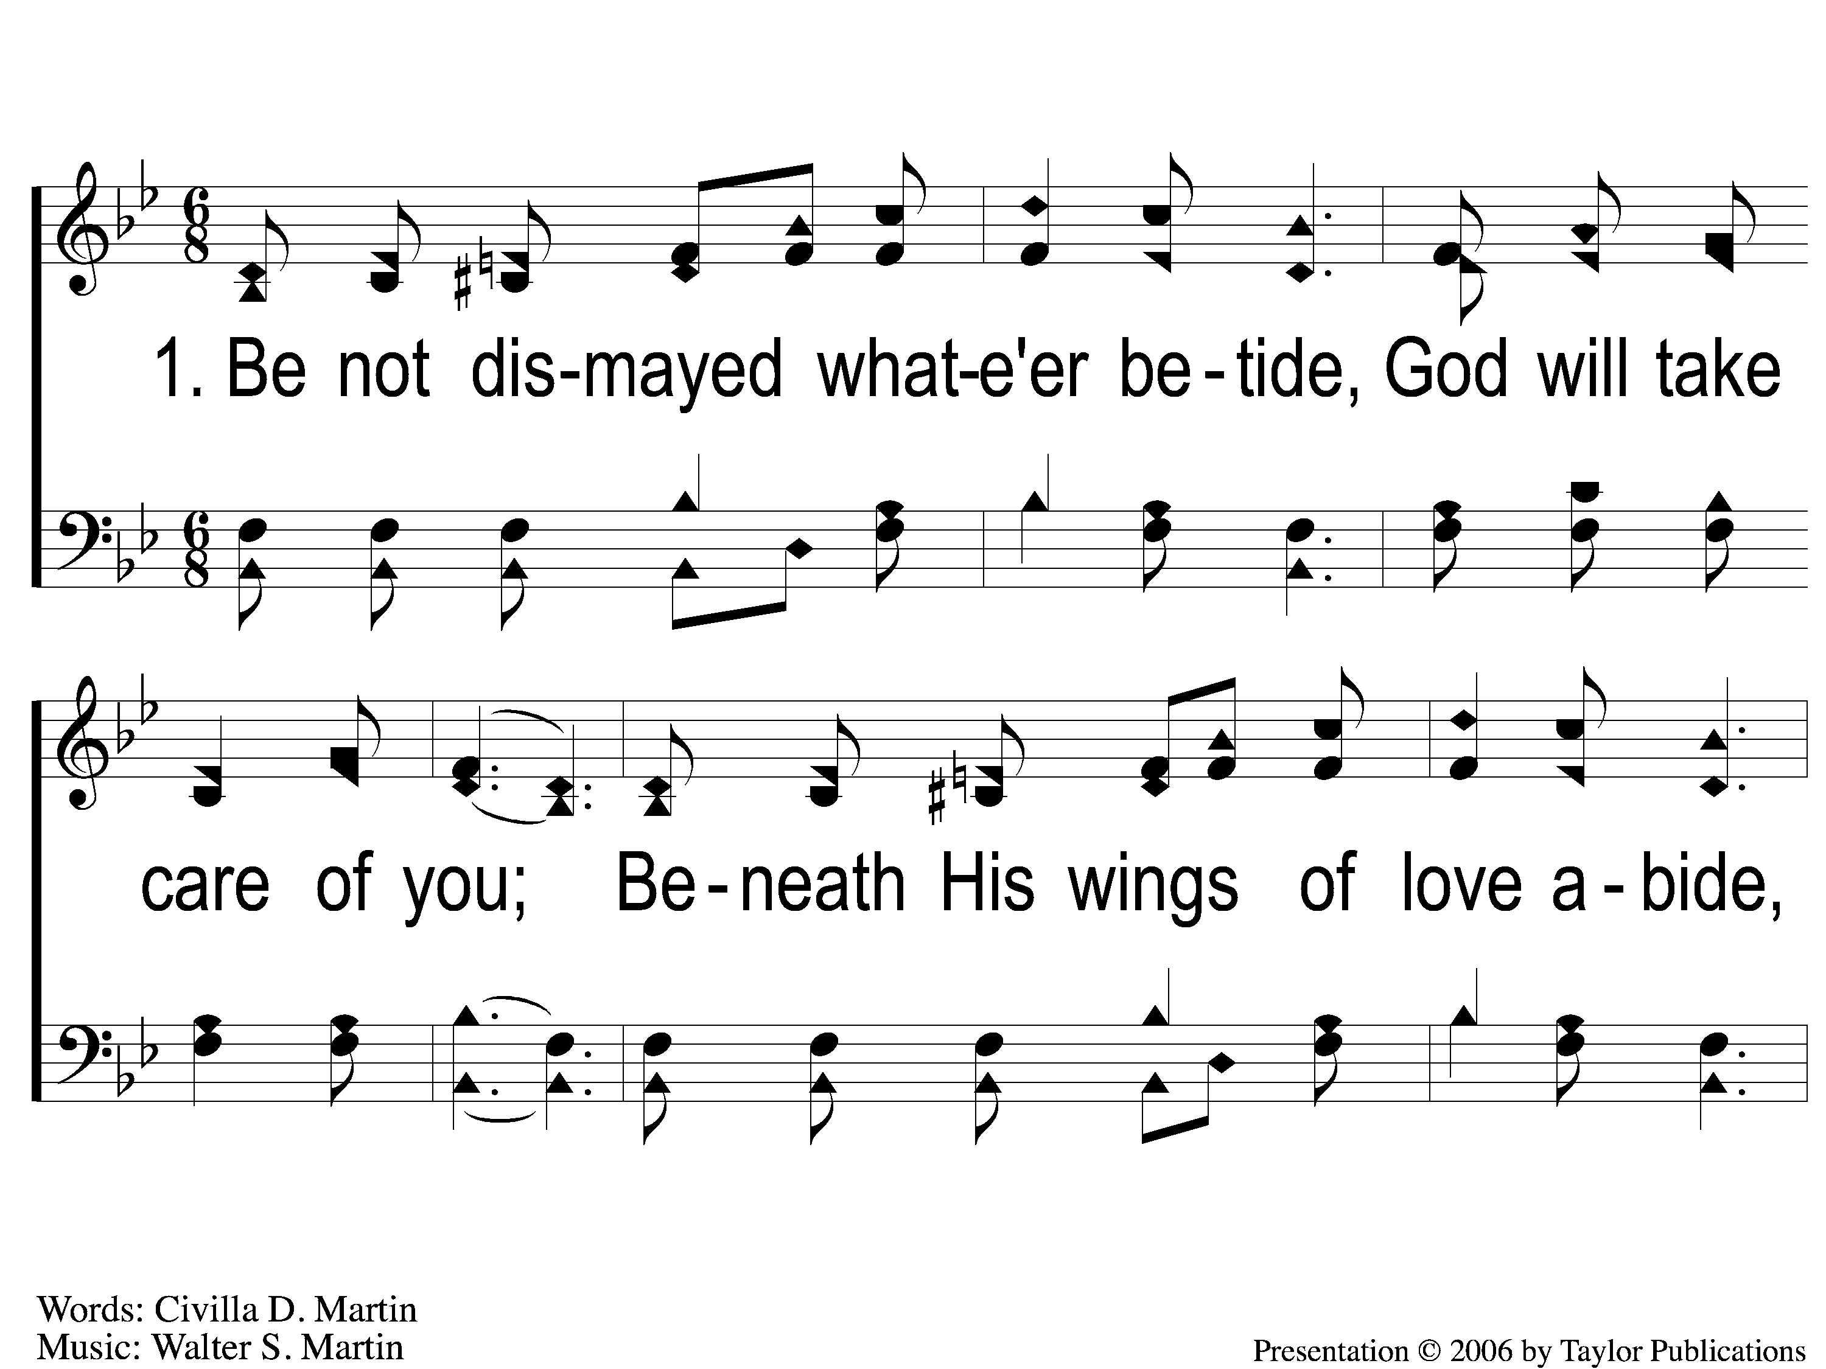
1-1 Be not dismayed whate’er betide
Be Not Dismayed Whate’er Betide
31

Slide 2
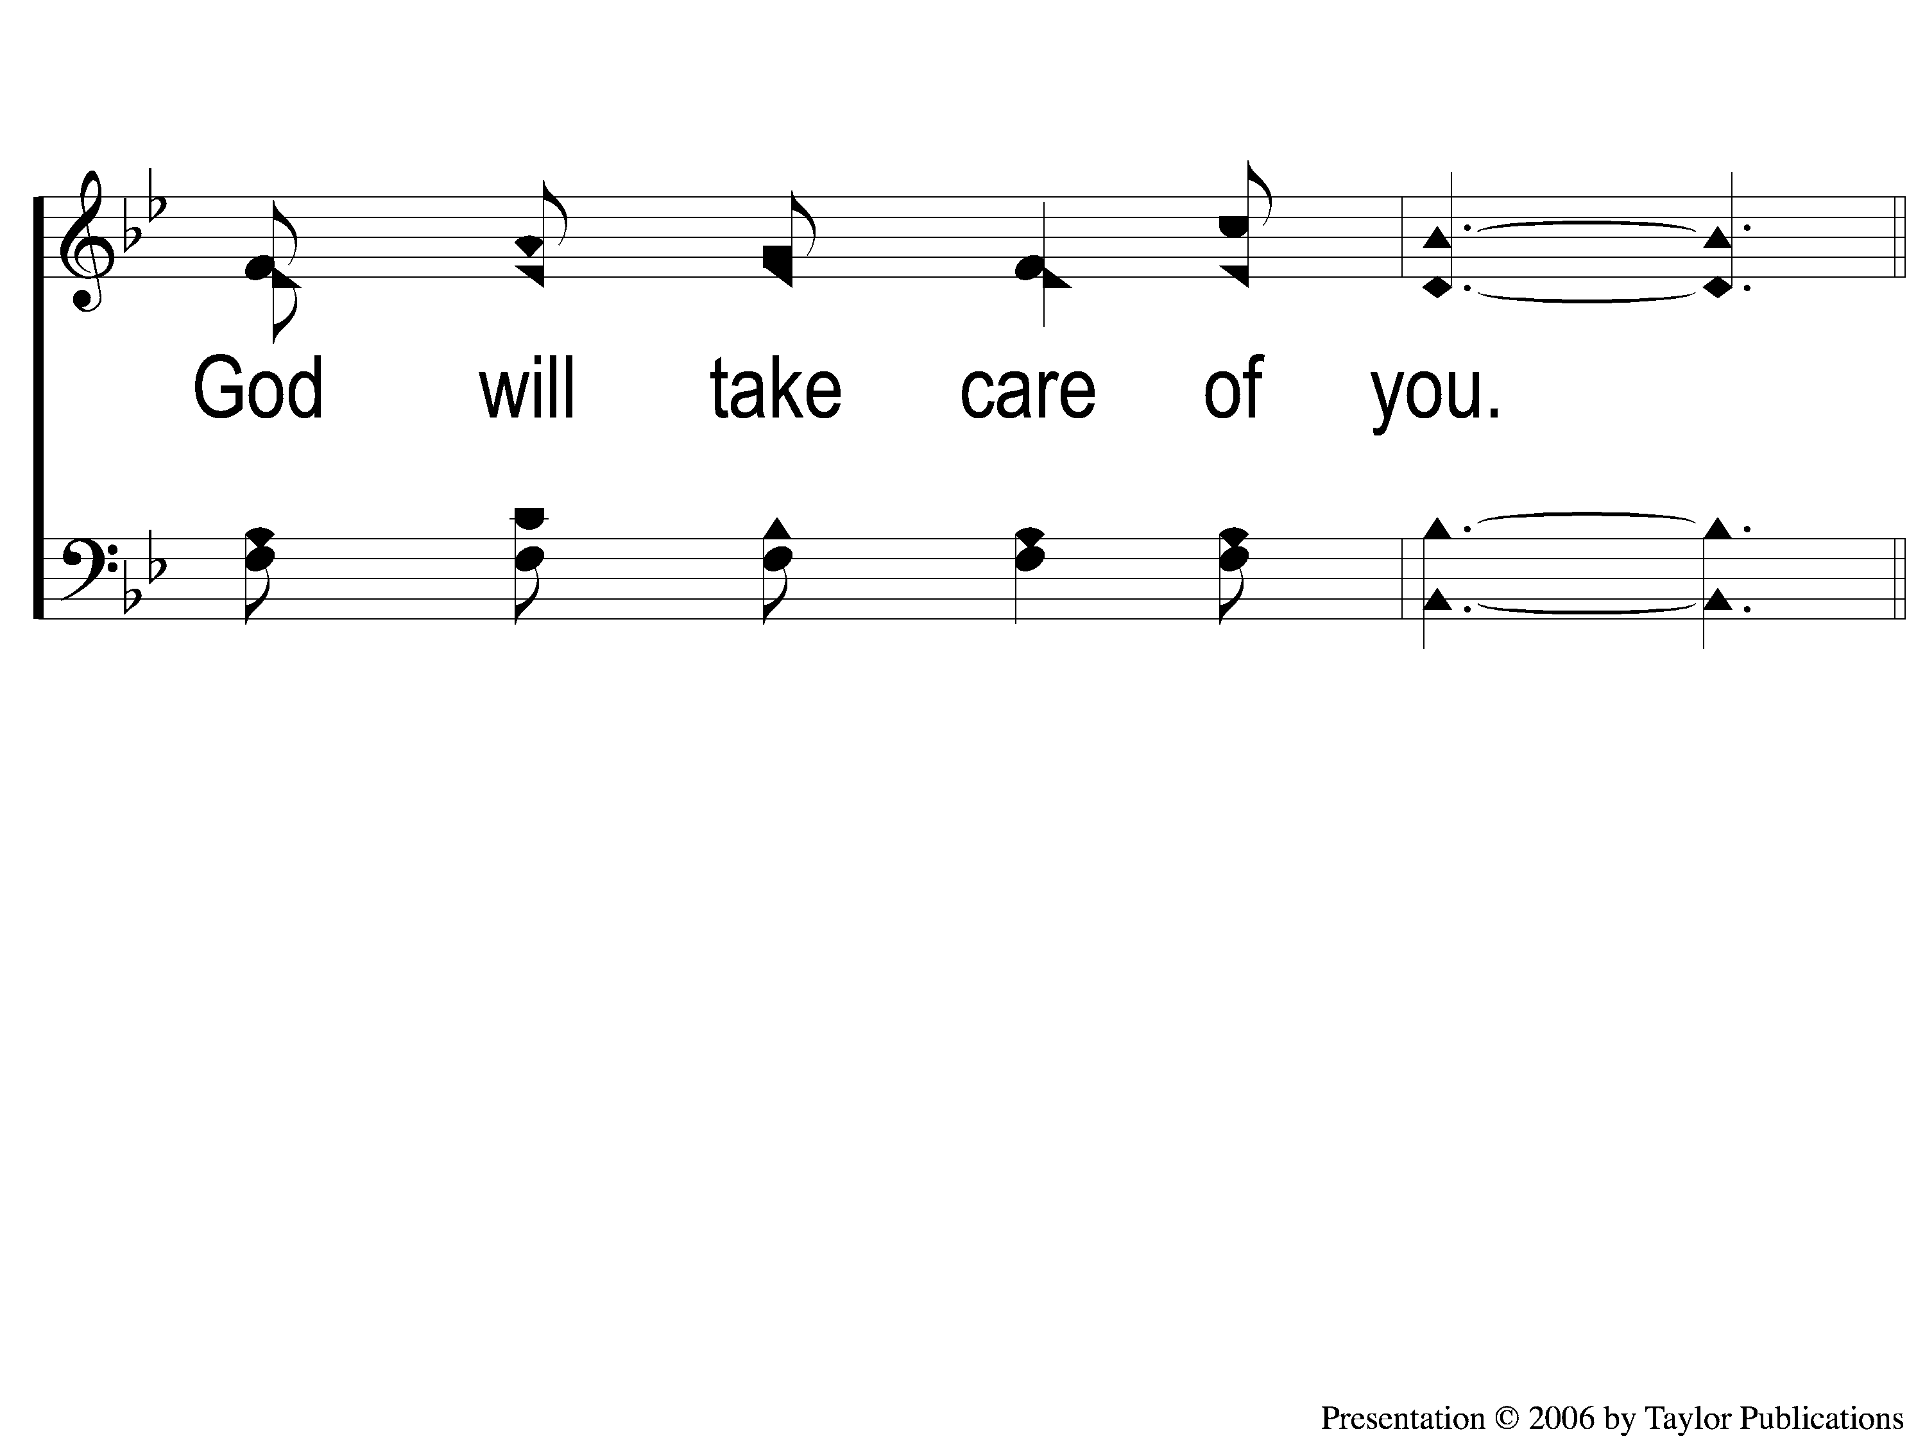
1-2 Be not dismayed whate’er betide
Be Not Dismayed Whate’er Betide
31

Slide 3
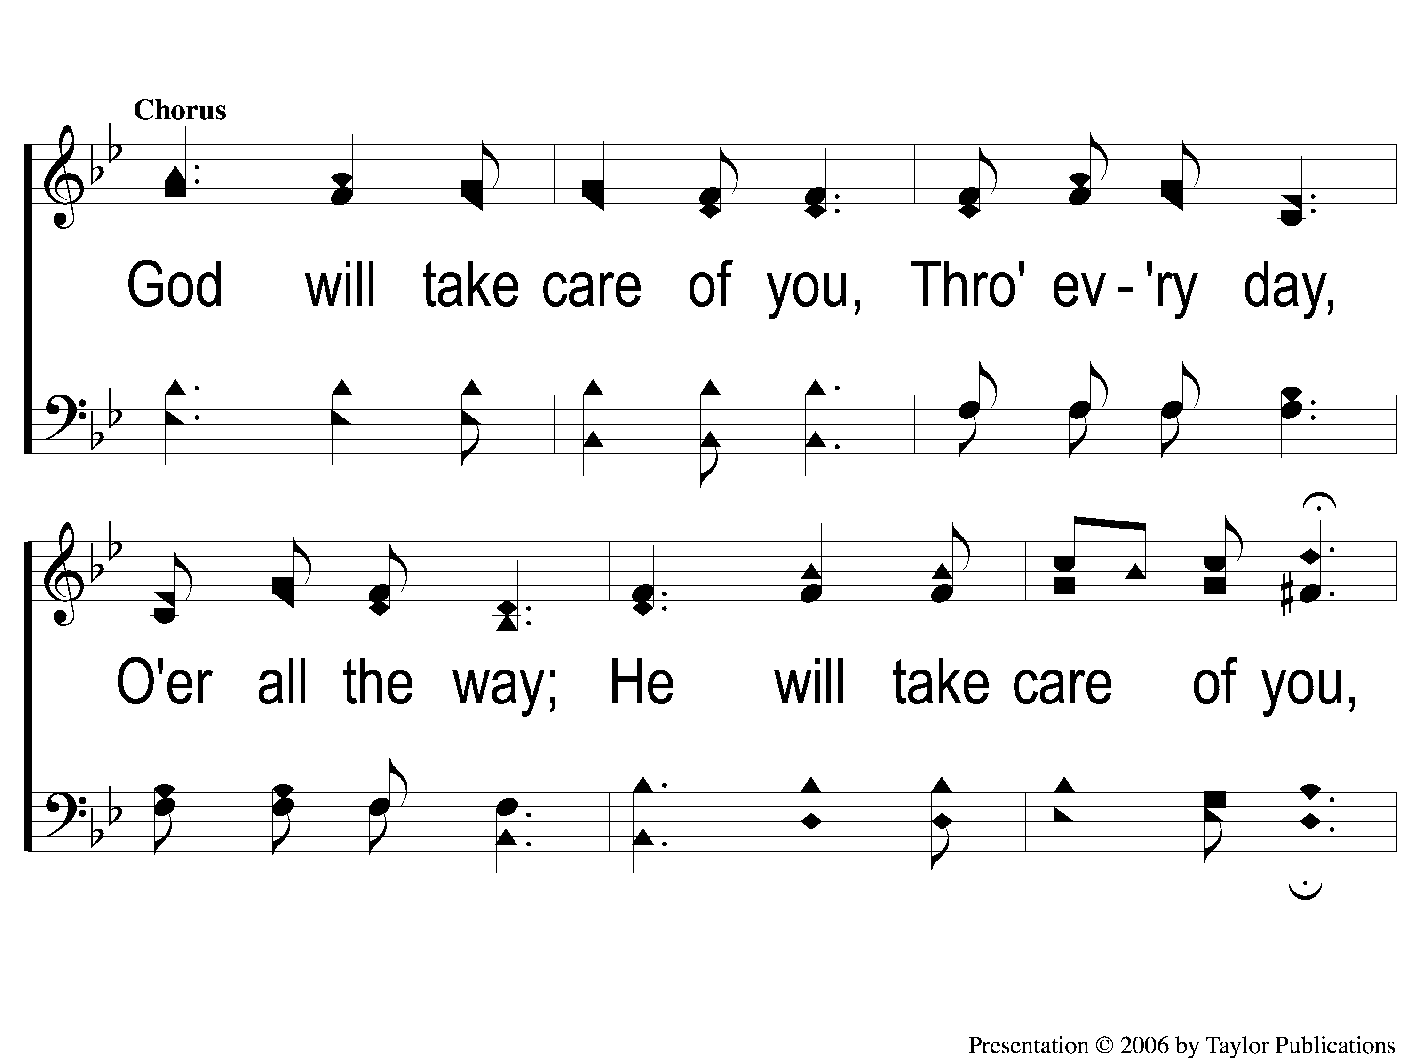
C-1 Be not dismayed whate’er betide
Be Not Dismayed Whate’er Betide
31

Slide 4
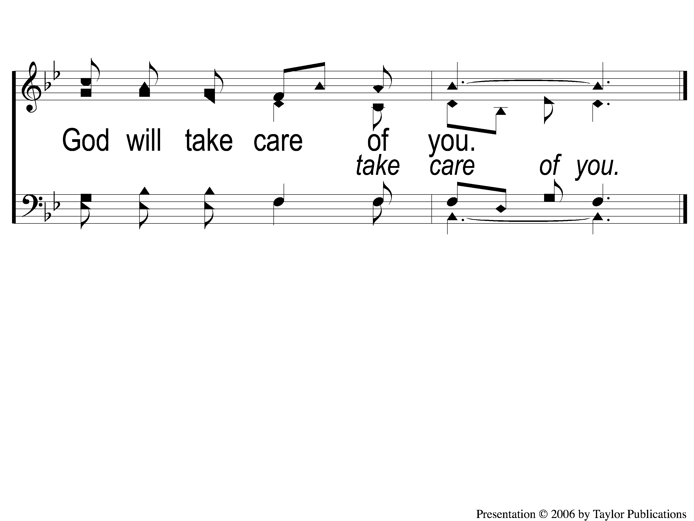
C-2 Be not dismayed whate’er betide
Be Not Dismayed Whate’er Betide
31

Slide 5
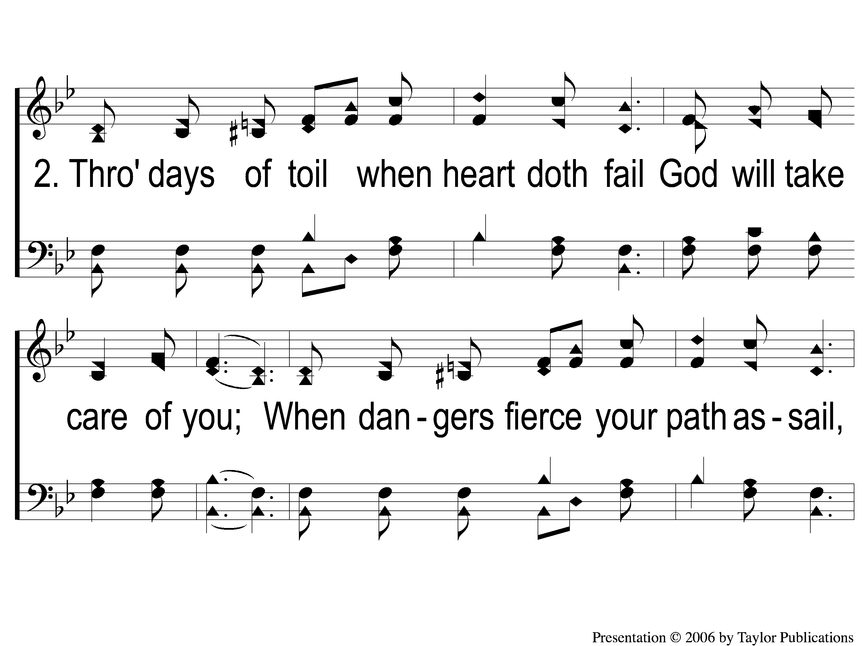
2-1 Be not dismayed whate’er betide
Be Not Dismayed Whate’er Betide
31

Slide 6

2-2 Be not dismayed whate’er betide
Be Not Dismayed Whate’er Betide
31

Slide 7
C-1 Be not dismayed whate’er betide
Be Not Dismayed Whate’er Betide
31

Slide 8
C-2 Be not dismayed whate’er betide
Be Not Dismayed Whate’er Betide
31

Slide 9
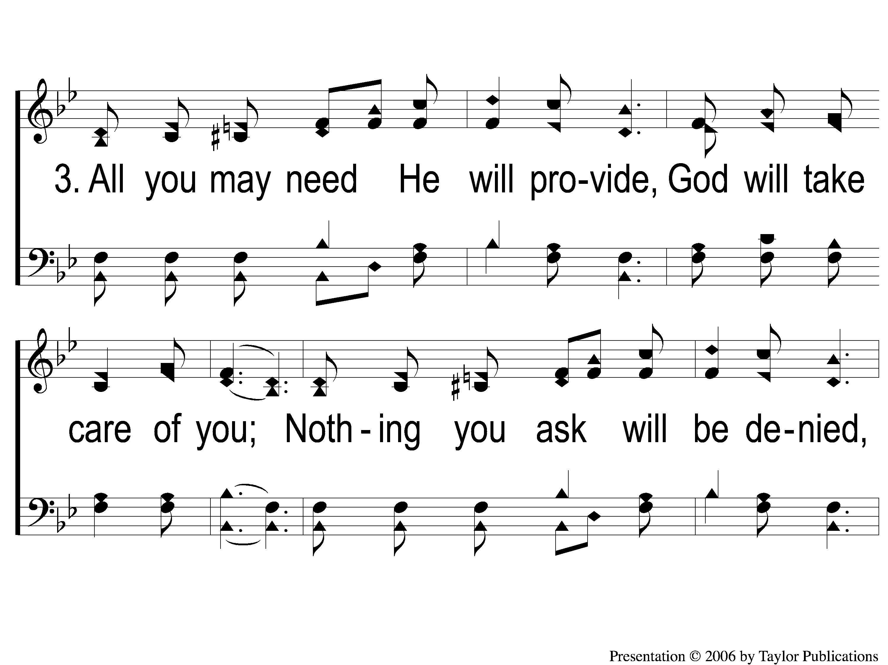
3-1 Be not dismayed whate’er betide
Be Not Dismayed Whate’er Betide
31

Slide 10

3-2 Be not dismayed whate’er betide
Be Not Dismayed Whate’er Betide
31

Slide 11
C-1 Be not dismayed whate’er betide
Be Not Dismayed Whate’er Betide
31

Slide 12
C-2 Be not dismayed whate’er betide
Be Not Dismayed Whate’er Betide
31

Slide 13
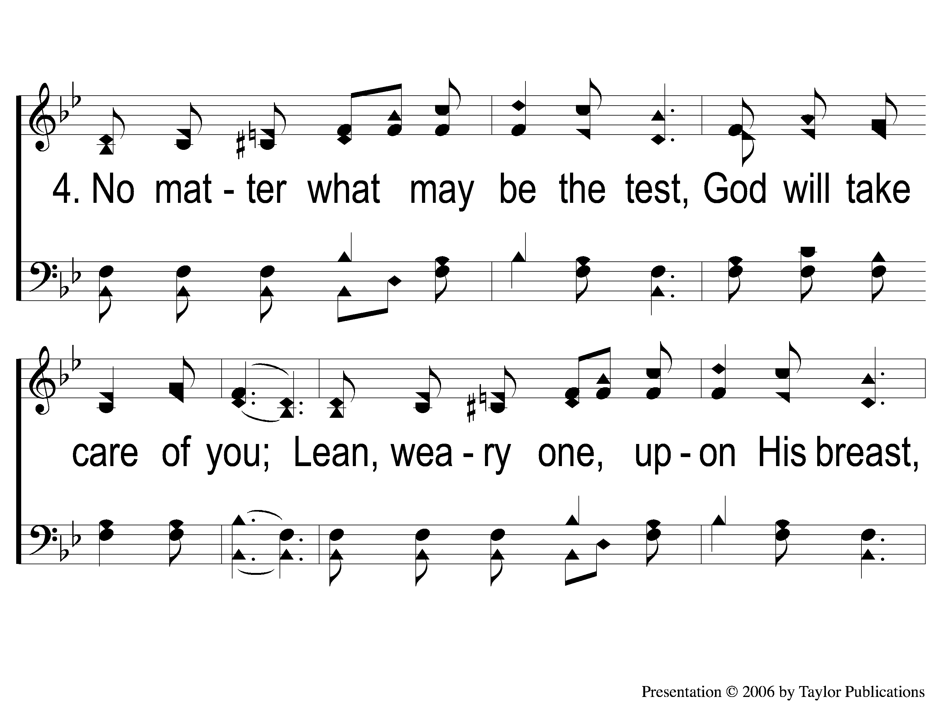
4-1 Be not dismayed whate’er betide
Be Not Dismayed Whate’er Betide
31

Slide 14

4-2 Be not dismayed whate’er betide
Be Not Dismayed Whate’er Betide
31

Slide 15
C-1 Be not dismayed whate’er betide
Be Not Dismayed Whate’er Betide
31

Slide 16
C-2 Be not dismayed whate’er betide
Be Not Dismayed Whate’er Betide
31

